Slide 1
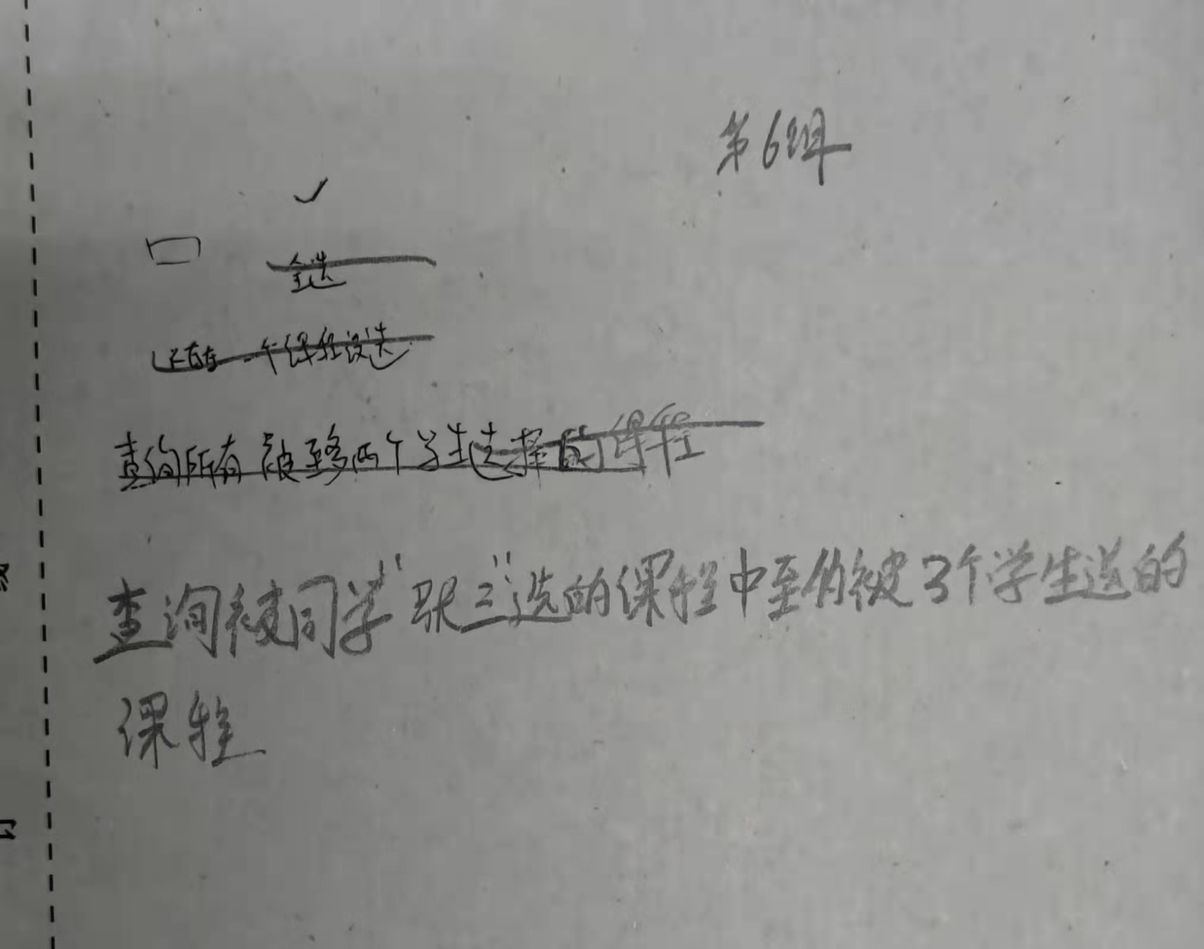

Slide 2
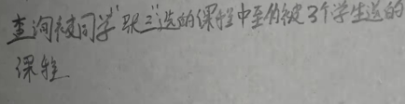
利用集合查询：
集合1：张三选的课； 集合2：最多有3个人选的课
求交集
Select SC1. cno
From SC SC1, Student S
Where SC1.sno = S.sno
And S.sname = ‘张三’
Intersects
Select SC2.cno
From SC SC2
Group by SC2.cno
Having count(*) <= 3

Slide 3
利用exists：
张三选的课，子查询要求这门课的学生人数小于等于3，子查询不为空
Select SC1. cno
From SC SC1, Student S
Where SC1.sno = S.sno
And S.sname = ‘张三’
And exists (
select SC2.cno
from SC SC2
where SC2.cno = SC1.cno
group by SC2.cno
having count(*) <=3
)

Slide 4
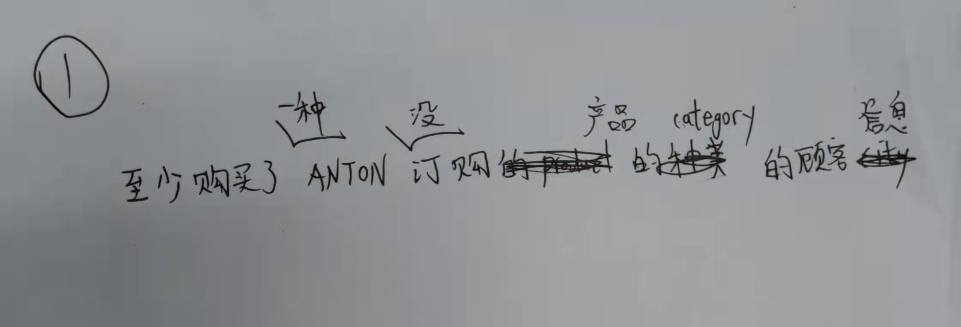

Slide 5
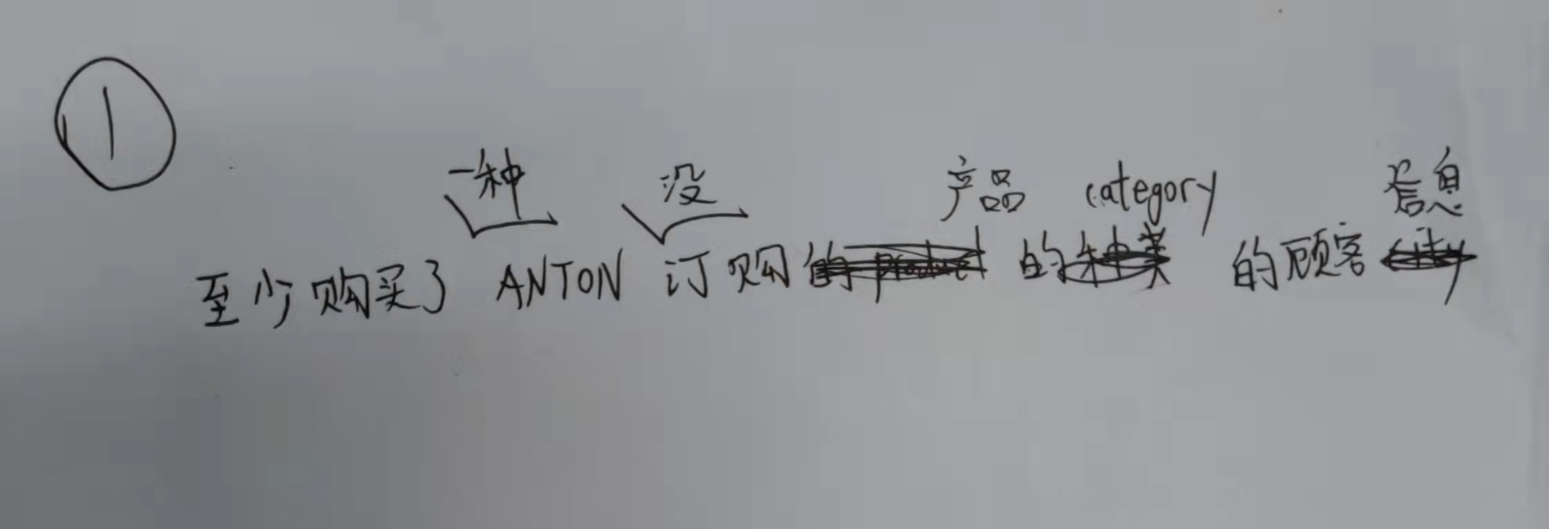
1、找出ANTON没订购过的产品 categoryID （orders, order details, products)
2、属于这些category有哪些产品
3、与orders、`order details`， customers做连接

Slide 6
select c1.*
from products p2 , orders o2, `order details` od2, customers c1 where p2.ProductID = od2.ProductID
and o2.OrderID = od2.OrderID
and c1.CustomerID = o2.CustomerID
and p2.CategoryID not in(
select p1.CategoryID
from orders o1, `order details` od1, products p1
where o1.OrderID = od1.OrderID
and p1.ProductID = od1.ProductID
and o1.CustomerID = 'ANTON' );

Slide 7
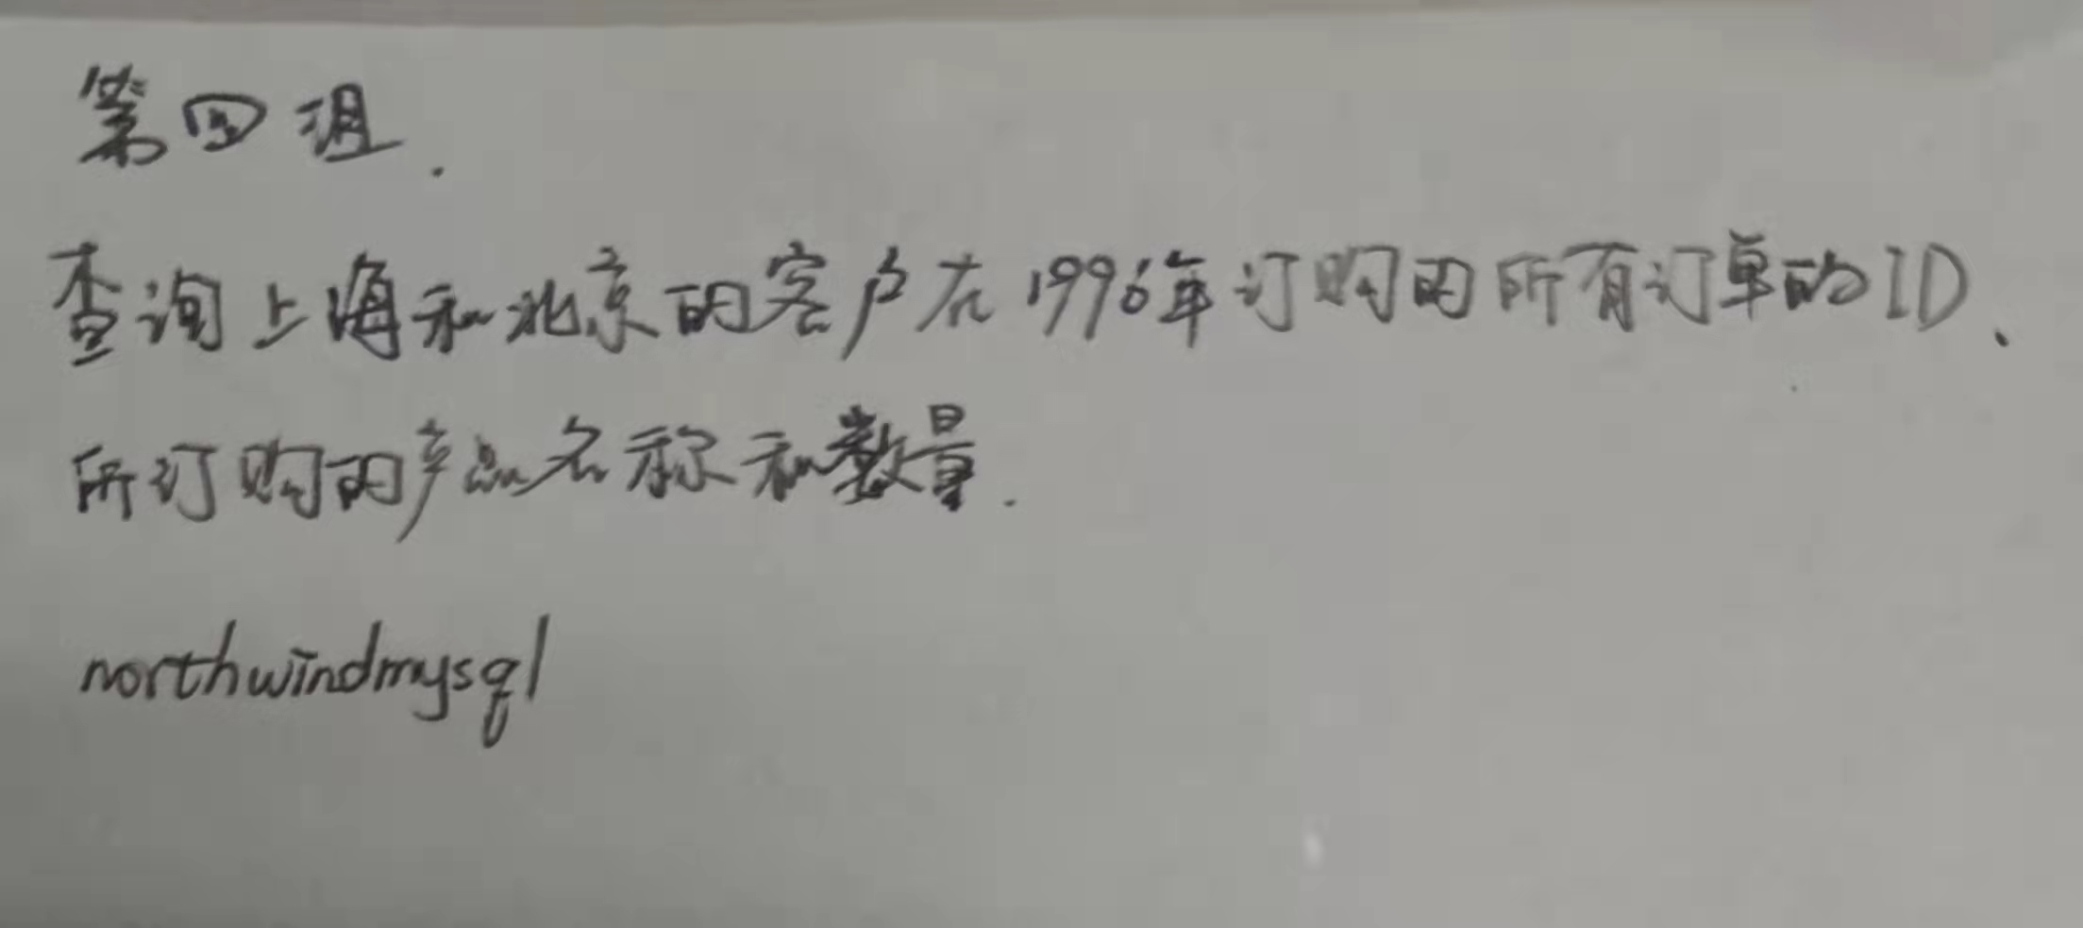

Slide 8
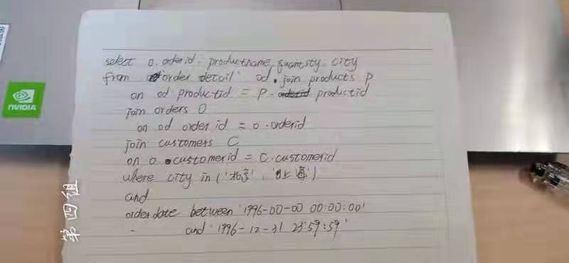
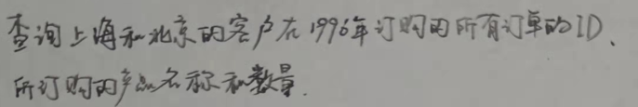

Slide 9
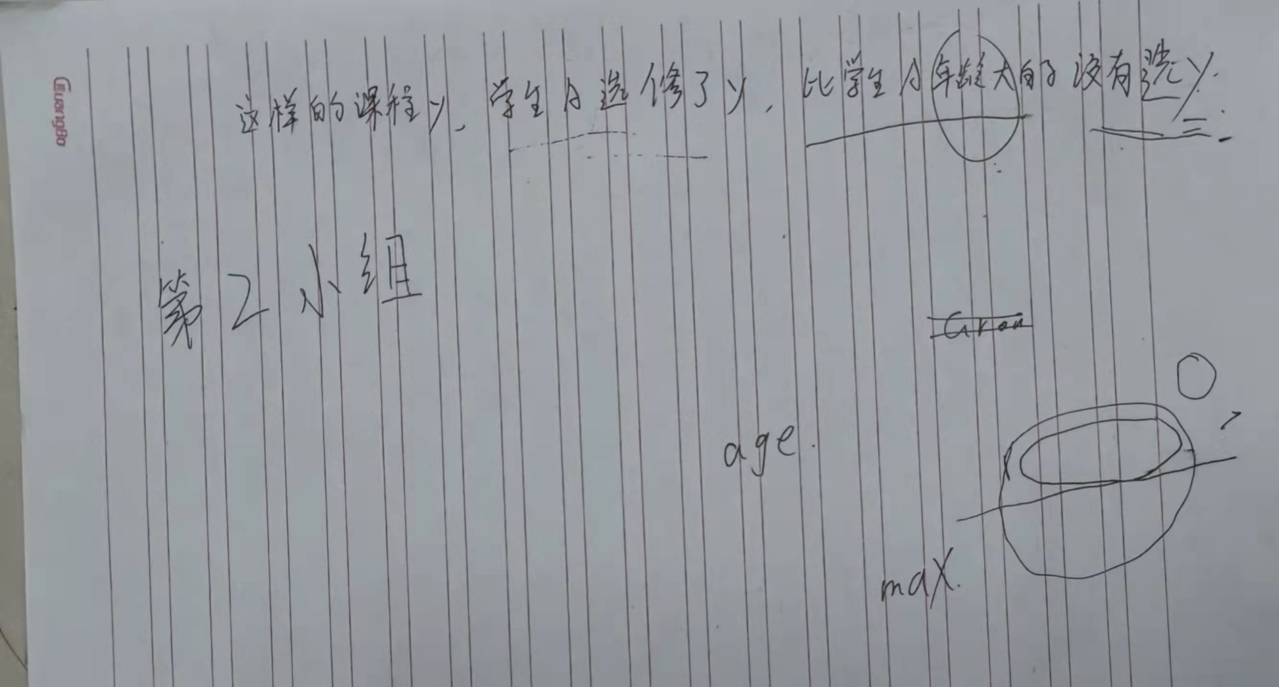

Slide 10
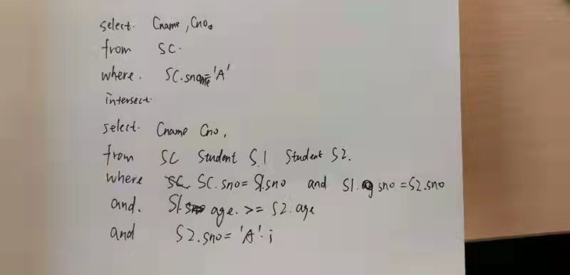

Slide 11
Select SC1.cno
From SC SC1, Student S1
Where SC1.sno = S1.sno
And S1.Sname = ‘A’
And not exists(
select *
from Student S2, SC SC2
where S2.sage>S1.Sage
and S2.sno = SC2.sno
and SC2.cno = SC1.cno)

Slide 12
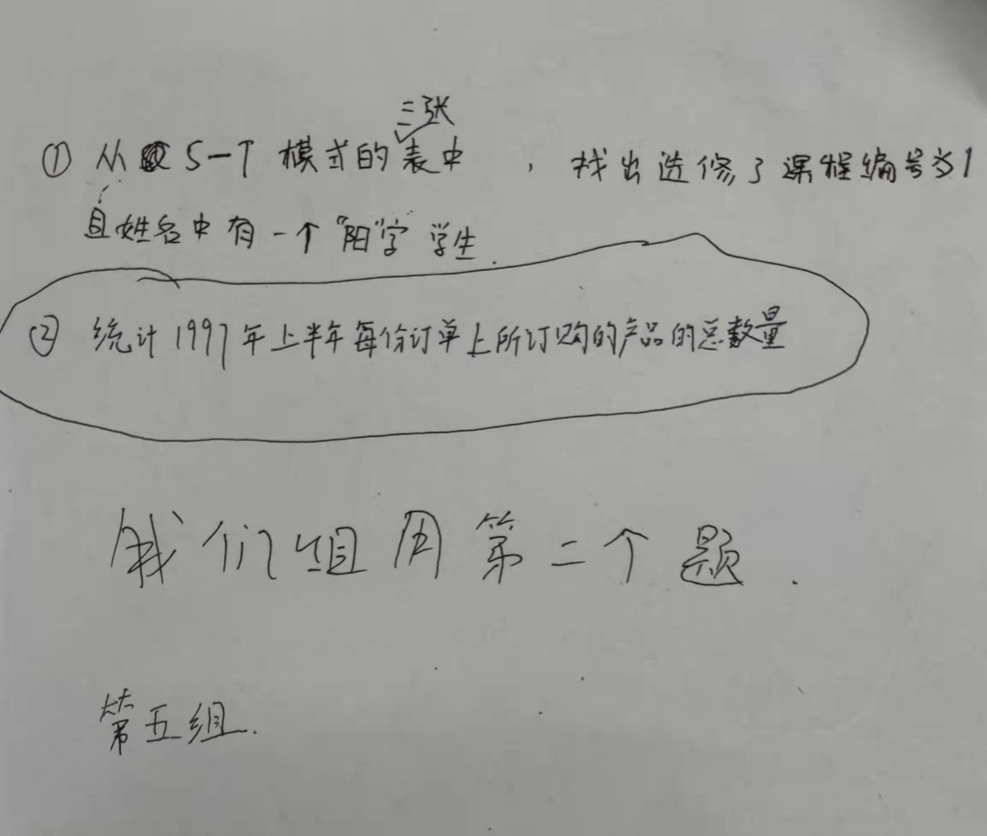

Slide 13

select o.orderid, sum(od.quantity)
from orders o, `order details` od
where o.orderid = od.orderidand year(o.orderdate)=1997
and month(o.orderdate)<7
group by o.orderid;

